Slide 1

Harnessing the Data Revolution
Chaitan Baru
Senior Advisor for Data Science, CISE
National Science Foundation
Delaware Data Science Symposium, May 12, 2017
1

Slide 2
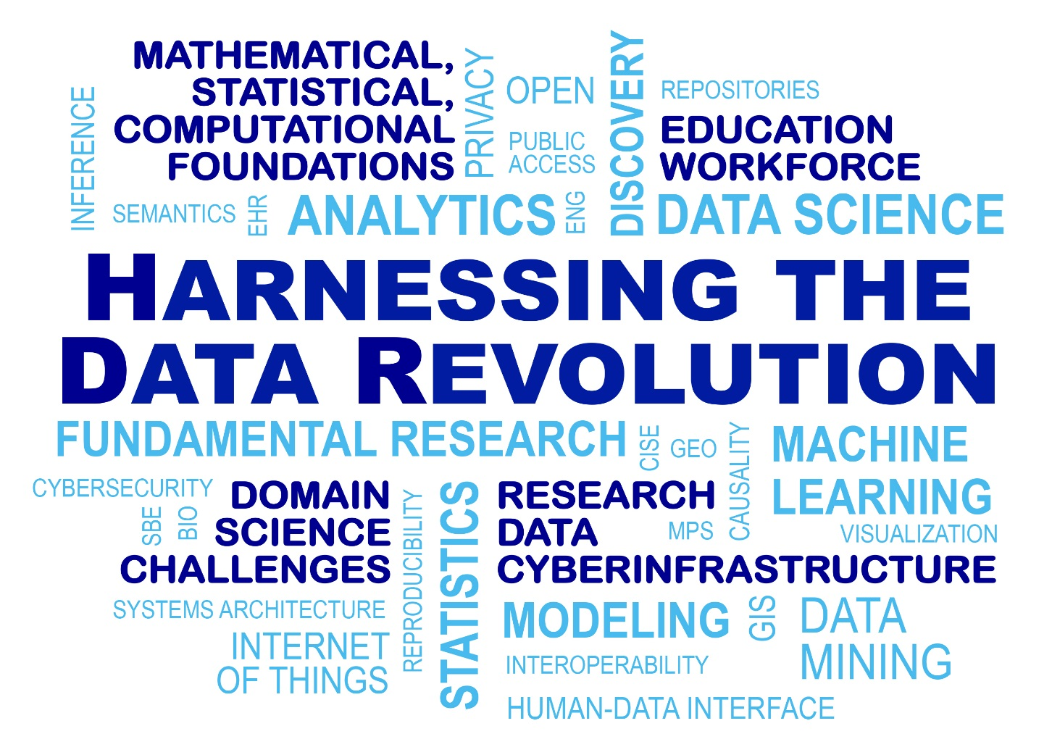
“Engage NSF’s research community in the pursuit of fundamental research in data science and engineering, the development of a cohesive, federated, national-scale approach to research data infrastructure, and the development of a 21st-century data-capable workforce.”
3

Slide 3
Harnessing the Data Revolution: five themes
Science domains
Systems, algorithms
Foundations
Cyber
infrastructure
Education,
Workforce

Slide 4

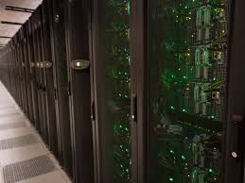
Harnessing the Data Revolution: five themes
Research across all NSF Directorates
Educational pathways
Science domains
Systems, algorithms
Theoretical foundations
mathematics, statistics, computer & computational
science
Systems, algorithms
data-centric algorithms, systems
Foundations
Innovations grounded in an education-research-based framework
Cyber
infrastructure
Advanced cyberinfrastructure
Data-intensive research
in all areas of science and engineering
Education,
Workforce
Accelerating data-intensive research
11

Slide 5


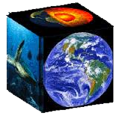
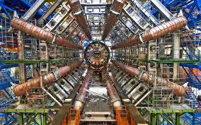




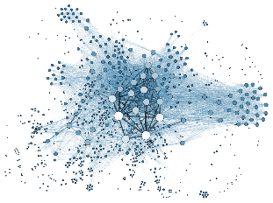
Harnessing the Data Revolution: Domains
Science domains
LHC
EarthCube
BIGDATA
RIDR
5

Slide 6

Harnessing the Data Revolution: Domains
Science domains
SBE
BIO
MPS
CISE
GEO
EHR
ENG
6

Slide 7
Harnessing the Data Revolution: Systems
Science domains
Science domains
Systems, algorithms
Predictive analytics
Data mining
Machine learning
Benchmark data sets
Integrity and accessibility
Privacy and protection
Human-data interface
LHC
EarthCube
BIGDATA
RIDR
7

Slide 8
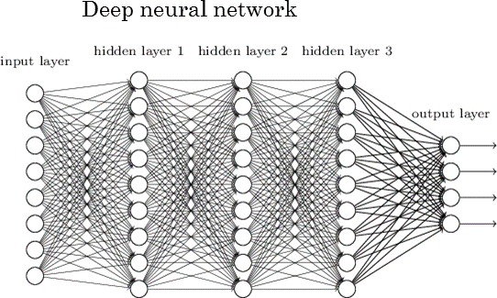
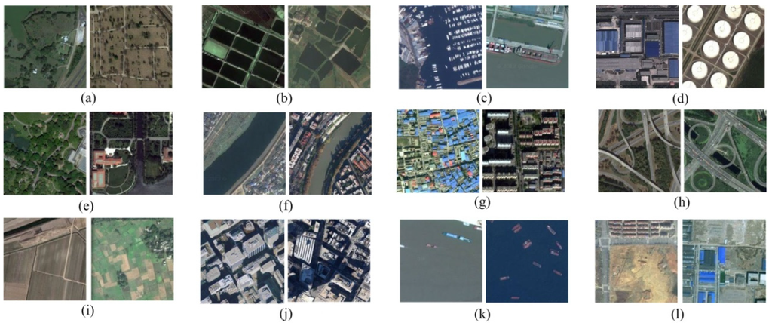



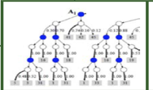
Fair, Interpretable, Transparent, and Trustworthy Data Science
Today’s ML systems: opaque, predictive interpretation hard
Trained opaque classifier
Systems,
Algorithms
prediction
Image training data
Accuracy?
new
image(s)
Explainability?
Why this prediction?
Why not another?
How to correct errors?
prediction
Fair, interpretable, transparent, trustworthy classifier
15

Slide 9
Harnessing the Data Revolution: Foundations
Science domains
Systems, algorithms
Foundations
Theoretical foundations for data-driven discovery and decision making: analysis and modeling of complex heterogeneous data
8

Slide 10
Foundations: Transdisciplinary Research in Principles of Data Science (TRIPODS) NSF 16-615
NSF Workshop on TFODS: Theoretical Foundations of Data Science, April 28-30, 2016. Sponsored by NSF CISE and MPS Directorates
design, enable center-scale collaboration on theoretical research among mathematicians, statisticians, computer and computational scientists
NSF TRIPODS
Requires CS, Stats, Math collaboration. Was due March 15, 2017.
Phase I: develop capacity, thematic directions for traditional center-like activities: research, education, workforce
A foundation for convergent research in data science

Slide 11
From workshop report (http://www.cs.rpi.edu/TFoDS/TFoDS_v5.pdf)
“…Theoretical Foundations of Data Science are fundamental for industrial applications and scientific understanding and there is demand for training students in this area…”
“…Data science is a broad discipline, covering everything from the experimental design phase and the data collection stage, all the way to the data analysis process and the inevitable decision making phase at the very end of the “data to knowledge to action” paradigm…”
“…theoretical foundations should have strong interfaces to application domains…”
“…Interdisciplinary collaboration between theoretical computer science, mathematics, and statistics is necessary to achieve significant progress…”
“…Data provenance, reproducibility, privacy, and algorithmic fairness are all fundamental topics…”

Slide 12
Harnessing the Data Revolution: Cyberinfrastructure
Science domains
Systems, algorithms
Foundations
Cyber
infrastructure
Robust, open, science-driven, integrated research CI ecosystem, with data as a “first-class
object”
9

Slide 13
Example: An Open Knowledge Network
Semantic information infrastructure: open web-scale knowledge network (semantically-linked concepts, data) to foster research on an entire class of new applications leveraging data, context, and inferences from data
question/answer interfaces, dialog-based interactions, explanatory
joint academia, industry, government workshops (Aug. 2016, Feb., 2017)
Systems,
Algorithms
Data Services for discovery, access, and integration of information across disparate, distributed information sources
16

Slide 14
Cyberinfrastructure Activities
A layered, federated architecture for a national cyberinfrastructure
E.g., storage layer
An idea for an Open Storage Network
Pilot being developed by community, with NSF Big Data Hubs
Semantic information infrastructure
The Open Knowledge Network
Enabling access to data
NSF Data DCL: Sharing federal agency data sets for machine learning, data science
Digital Repositories
NITRD Workshop on Metrics for Digital Data Repositories
NSF workshop on business models for sustainability of digital repositories (in planning)

Slide 15
Harnessing the Data Revolution: Education
Science domains
Systems, algorithms
Foundations
Cyber
infrastructure
Education,
Workforce
10

Slide 16
HDR Education and Workforce
Research-based understanding of knowledge, demands of STEM-capable workforce
range of needs/opportunities: technicians through PhD
inherently multi-disciplinary
“Birth” of a new discipline?
NAS study (CSTB, CATS, BOSE): “Workshop on Envisioning the Data Science Discipline: The Undergraduate Perspective”
two workshops, report: 2017
unique challenges, innovations needed
NSF DCL on Growing Convergence Research at NSF
Section on HDR Education and Training
Education,
Workforce
17

Slide 17
Harnessing the Data Revolution: Convergence!
Enabling long-term, deep collaborations among:
Theory: CS, Math, Stats, Computational Science researchers
Domain scientists: BIO, CISE, EHR, ENG, GEO, MPS, SBE
Cyberinfrastructure experts
to collaborate on critical, community-identified data-driven research challenges
Science domains
Systems, algorithms
Foundations
Cyber
infrastructure
Workforce
12

Slide 18
Putting it all Together: Translational Data Science
Development, application of data science in the science domains to enable discovery
Cyber
infrastructure
Foundations
Science domains
(including big ideas)
Systems,
algorithms
Education
Workforce
NSF is uniquely positioned to execute on the convergent, full-breadth of HDR activities
20

Slide 19
Harnessing the Data Revolution: Possible Activities
Creating center-scale activities, RCNs
theoretical foundations
systems foundations
domain-focused data-centric research
education
Deploying robust cyberinfrastructure
Accelerating investments in existing data-related programs
Science domains
Systems, algorithms
Foundations
Cyber
infrastructure
Workforce
13

Slide 20
Urgency: A national imperative
“engage NSF’s research community in the pursuit of fundamental research in data science and engineering, the development of a cohesive, federated, national-scale approach to research data infrastructure, and the development of a 21st-century data-capable workforce.”
Science and
Engineering
Research
Just as computational science transformed scientific research in the 20th century, so too can data science fundamentally transform scientific research in this century.
Just as HPC and NSFNET enabled and accelerated new science and engineering research in the 20th century, so too can national-scale data infrastructure have a profound impact on science and engineering discoveries in this century.
Research
Infrastructure
If not us, who? If not now, when?
21

Slide 21
Thank You!

Slide 22
Backup Slides

Slide 23

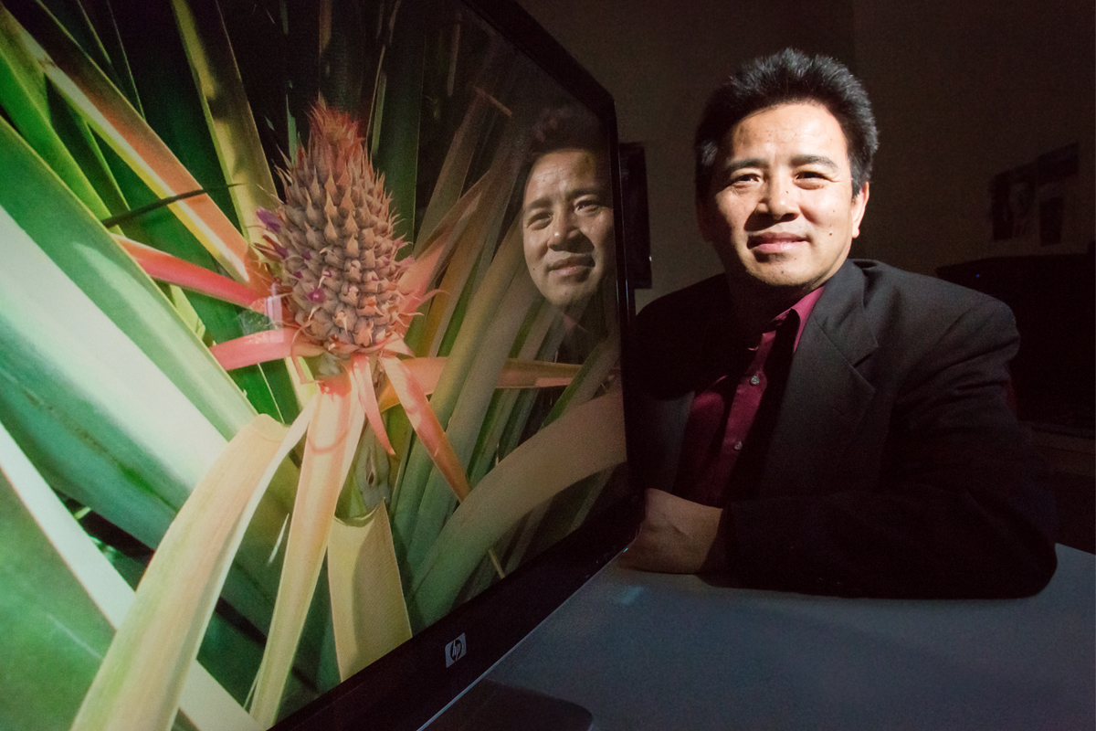









Developing HDR cyberinfrastructure within a shared architectural vision
Cyber
infrastructure
Discipline –specific
Environments
Applications,
Frameworks
Science
Portals
Research Facilities
…
Integrative
Services
OSG
Education, Governance, Sustainability
Data Management
HPC access, community
Increasing interdisciplinary sharing
Collaboration Platforms
Authentication
Workflow Systems
international
private, commercial clouds
campus, national resources
NSF-supported
resources
Resources
National/International Research and Education Networks, Commercial Networks
18

Slide 24
Possible HDR Cyberinfrastructure Activities
Cyber
infrastructure
Applications,
Frameworks
Mid-scale activities
Driven by research priorities, workflows
Shared data, middleware, analysis tools
Integrating with, expanding, existing capabilities
Multiple science domain “verticals”
Science
Portals
Research Facilities
…
HPC access, community
OSG
Data Management
Collaboration Platforms
Authentication
Workflow Systems
international
private, commercial clouds
campus, national resources
NSF-supported
resources
National/International Research and Education Networks, Commercial Networks
19

