Slide 1
Data science investments at Georgia tech
• Data Science Foundations
• Data Driven Discovery
Srinivas aluru
Georgia Institute of technology

Slide 2
GT Interdisciplinary research institutes (iri)
Primary mechanism for EVPR to manage GT research enterprise
Coalesce GT researchers around core research themes
Maintain a large portfolio of basic and applied research programs
Support world-class research facilities and laboratories
Engage GT students
Collaborate with government and industry partners

Slide 3
GT Interdisciplinary research institutes (iri)
Parker H. Petit Institute for Bioengineering and Bioscience
Institute for Data Engineering and Science
Institute for Electronics and Nanotechnology
Strategic Energy Institute
Institute for Information Security and Privacy
Georgia Tech Manufacturing Institute
Institute for Materials
Institute for People and Technology
Renewable Bioproducts Institute
Institute for Robotics and Intelligent Machines
Brook Byers Institute for Sustainable Systems

Slide 4
Data science across GT
GTRI
College of
Computing
College of
Engineering
College of
Science
Sensors
Signal Processing
Health Analytics
Security
HPC
Machine Learning
Algorithms
Cloud Computing
Optimization
Logistics
Image & Signal Proc.
Discrete Math
Physics
Bio-Informatics
Modeling
Neuroscience
Institute for Data
Science and Engineering
Manufacturing
Biomedical
Energy
Materials
College of
Business
Ivan Allen College
College of
Architecture
Data Analytics
Finance
Privacy
Public Policy
Economics
Social Media
Planning
Transportation

Slide 5
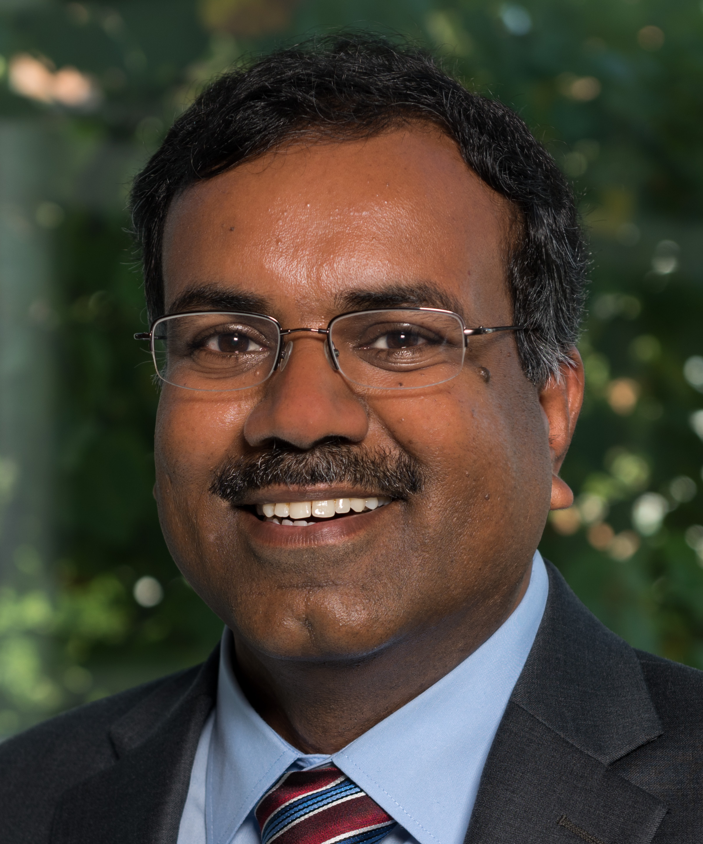
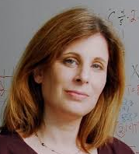
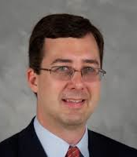
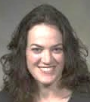
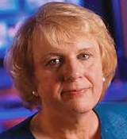
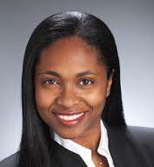

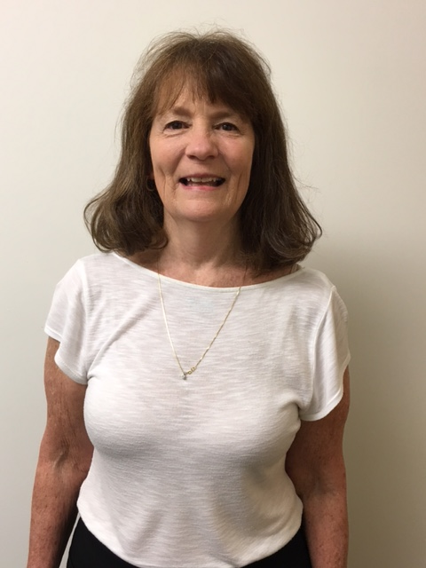

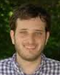
People of idEas
Co-Executive Directors:
Srinivas Aluru Dana Randall
Associate Dir. of Associate Dir. of Associate Dir. of
Research & Research and Res. Infrastructure
Education Strategic Initiatives & Shared Resources
David Sherrill Deirdre Shoemaker Marilyn Wolf
Director of Industrial Director of
Partnerships: Communications
and Grant Writing:
Dr. Renata Rawlings-Goss Dr. Jennifer Salazar
Financial Admin: Admin Professional: Web Support:
Claudia Clarkson Shkina Halbert Eric Korotkin

Slide 6
Institute for Data Engineering and Science
Industry
Partnerships
Energy
Foundations
Domains
Industry

Slide 7
Affiliated centers: data science foundations
ML – Center for Machine Learning (Irfan Essa)
HPC – Center for High Performance Computing (Richard Vuduc)
CRNCH – Center for Research on Novel Computing Hierarchies (Thomas Conte)
ARC – Algorithms and Randomness Center (Eric Vigoda)

Slide 8
data DRIVEN Discovery
Big Data for Smart Cities
Health analytics and precision medicine
Materials informatics
Energy in the Information Age

Slide 9
Ideas activities
Large center-scale activities (e.g. NSF BD Hubs, DHS Center on Quantiative Analysis)
IDEaS Labs; Data Repositories
Workshops in focus areas
Mini-retreats: IDEaS in Research, IDEaS for the Future
  E.g. Data Science for Pediatrics
Monthly networking gatherings
Data Science “modules,” short courses, specialized training
Seminars / Distinguished Lecture Series

Slide 10
IDEAS: Industry Alliance Program
Workforce and Training Research and Support
Connect with IDEaS faculty and students
Gain greater visibility with company branding
Disseminate company job announcements to GT students in relevant fields.
Interact with GT researchers in an area of interest to your company
Attend Annual members only industry day
Serve on Industrial Advisory Board (limited seats)
Get dedicated one-on-one or onsite site time with IDEaS faculty, researchers and students to forge deeper connections
Host an event focused exclusively on your company
Direct some tier funding to mutually agreed upon research projects.
Contact us at:
ideas.connect@gatech.edu
ideas.gatech.edu

Slide 11
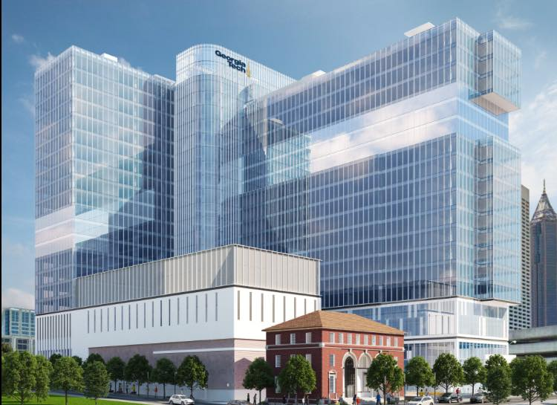
Coda building

Slide 12
Nsf big data regional innovation hubs
Multi-stakeholder partnerships to go after regional/national/societal big data challenges
Set standards, share best practices
Provide data resources, develop infrastructure, create testbeds
Technology transfer, incubation
Education and workforce training
Engage with thought leaders, develop public awareness and ease adoption

Slide 13
Alaska & Hawaii are part of the West region
US Territories can participate in any region
106 Personnel
79 Organizations
12 states
NORTHEAST
MIDWEST
193 Personnel
99 Institutions
9 States
UW (PI)
UND(co-PI)
U of M (co-PI)
Iowa State (co-PI)
Columbia (PI)
Berkeley (PI)
Indiana U (co-PI)
UIUC/NCSA (PI)
UNC/RENCI (PI)
UCSD/SDSC (PI)
WEST
Georgia Tech (PI)
University
86 Personnel
47 Organizations
13 States
HPC Center
Non-profit
SOUTH*
Government
BD Hubs
Industry
116 Personnel
95 Organizations
16 States + DC
Points indicate affiliations of individuals named as steering council members and/or task leads.
*South points indicate Senior Personnel
Notes:
A little more about the BDHubs. In September, NSF announced four awards totaling more than $5 million to establish regional hubs for data science innovation.
The consortia are coordinated by top data scientists at Columbia University (Northeast Hub), Georgia Institute of Technology and the University of North Carolina (South Hub), the University of Illinois at Urbana-Champaign (Midwest Hub) and the University of California, San Diego, the University of California, Berkeley, and the University of Washington (West Hub).
Covering all 50 states, they include commitments from more than 250 organizations--from universities and cities to foundations and Fortune 500 corporations--with the ability to expand further over time. The organizational structure for each BD Hub varies by region. Some are organized into standing sub committees and task forces, others into flexible working groups. You see on this map not only the Hub coordinators, but also the organizations leading the subcommittes and sub divisions of each Hub.

Slide 14
NSF Big Data Hub Investments
Hubs launched in September 2015 ($6 million)
$1.2M for nurturing academia-industry collaborations
BD Spokes competition in Feb 2016
  10 spoke proposals at $1M each
  10 spoke planning proposals at $100K
Next round BD spokes competition on

Slide 15

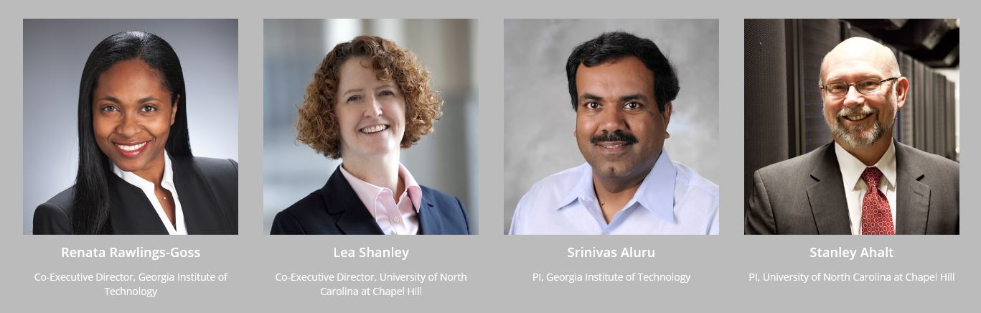
Co-Executive Directors
Georgia Institute of Technology
University of North Carolina at Chapel Hill
Renata Rawlings-Goss
Lea Shanley
PIs
Srinivas Aluru
Stan Ahalt

Slide 16


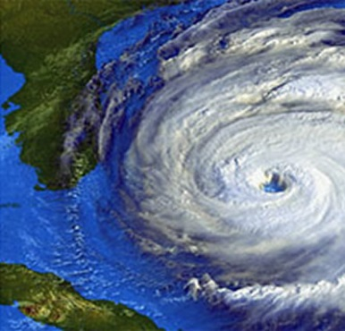




South BD Community Priority Areas
Big Data Sharing and Infrastructure
Healthcare
Coastal Hazards
Economics, Privacy and Policy Issues
Industrial Big Data
Materials and Manufacturing
Habitat Planning

Slide 17
South big data regional innovation hub
≈ 30M from NSF over 4 Hubs in 3 years
Activities:
Spoke projects
Working groups
Workshops
Industry internships
Cloud provider partnerships
Building data assets
Data Science education
Hack-a-thons
Outreach to minority serving and community colleges
> 700 affiliated members
300+ Organizations
16 States + DC

Slide 18
Getting Involved in the South Hub
Notes:
Steering Committee
Executive Committee
Technical Advisory Co

