Slide 1
Center for Exploratory Sensing
Concept for a Science and Technology Center
Sensor Technology: Remote, Adaptive, Targeting and Exploring Extreme Environments (STRAT-EEE)

Slide 2
Vision
There is a profound need for automated and adaptive sensor networks that enable exploration, monitoring, and understanding of chemical spaces in the environment.
The networks should function beyond quantitative detection of target analytes, but to provide insight into the current and future chemical reactivity.
The sensor networks should be resilient in a changing environment, enabling dynamic adaptations to interferents and spatial/temporal heterogeneity.

Slide 3
State of the Art – Usually One or Both Together
‘High Information’ Stationary Assets
Many different analyses
Superior chemical resolution
Operates near continuously
Mobile Asset
Few analyses
Limited chemical resolution
Operates on fixed course

Slide 4
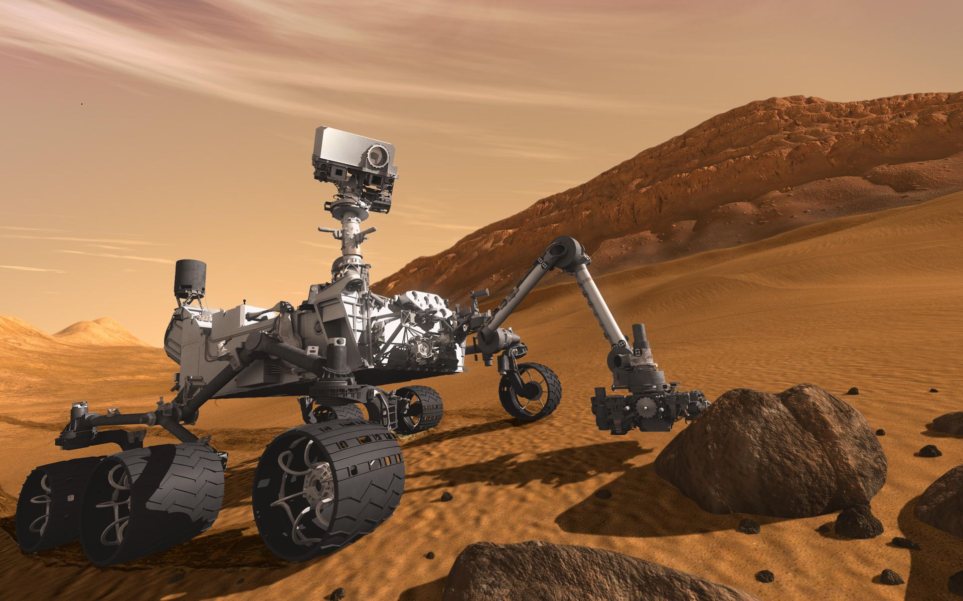
State of the Art - Best Case Scenario
Curiosity Rover
Alpha Particle X-Ray
LIBS (CheCam)
X-Ray Diffraction (CheMin)
MS, GC, Laser (SAM)
2 Radiation detectors
Visual cameras guide the rover
No chemistry information beyond its footprint!

Slide 5
Challenging Applications for State of the Art
Tracking after-effects of an oil spill and mapping bioavailability
Monitoring agricultural run-off over a growing season and predicting time and location of algal blooms or fish kills
Determining spatial distribution of health or environmental risk following an event – e.g. Katrina, urban terrorist attack, wild fire, earth quake.
Exploring the dynamic chemical landscape in an extreme environment – e.g. deep sea hydrothermal vent systems or space exploration.
Threat detection and assessment on a battlefield

Slide 6
Vision: Adaptive, Integrated, Mobile Tiers of Sensors
Stationary Assets
Fast swarm surveys and guides platforms
One or more mobile platform in a swarm

Slide 7
Vision: Network Components
Small, fast sensors
Only one or two tasks per unit with low power, rapid analyses
High spatial and temporal resolution
Simple measurements
Physical – turbidity, RI, salinity, conductivity, pressure, etc.
Chemical – pH, fluorescence, absorbance, FET arrays, etc.
Mobile connective drones
Slower, more specialized analyses
Both target analyte specificity and ability to survey ‘unknowns’
Multivariate measurements
Raman (surface enhanced), excitation-emission fluorescence, infrared spectroscopy, microfluidics, etc.
Stationary (or less mobile) assets
High chemical specificity, but inability to rapidly or dynamically survey an area
Ground or moored sampling stations, Mass Spectroscopy, LIDAR, etc,

Slide 8
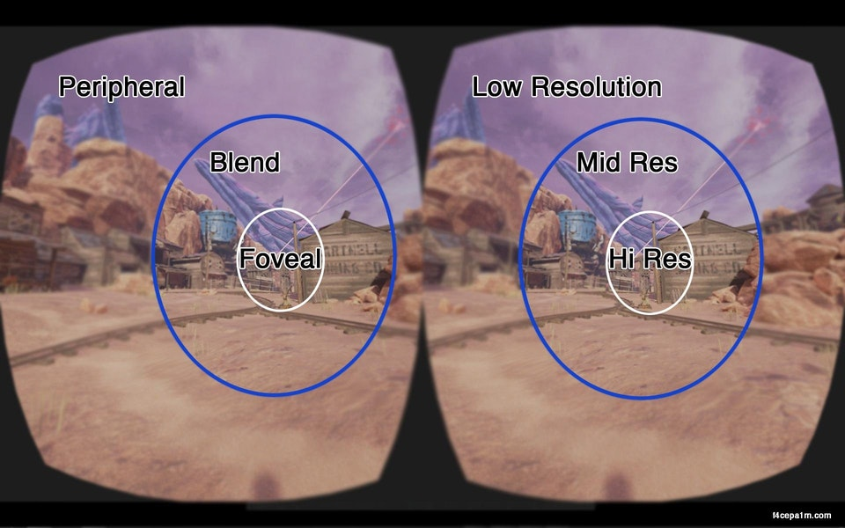
Vision: Enable ‘Foveated Sensing’
Fast sensors survey chemical landscape
Increase resolution around ‘interesting’ areas
Guide mobile platforms for more informative measurements.
Stationary platforms help with calibration
Example of Foveated Imaging

Slide 9
Needs: Research Areas to Realize Center
Portable Multivariate Sensors
Microfluidics
Spectroscopy
Electrochemistry
Surface modifications for selectivity and sensitivity
Smart, responsive materials
Modeling
Experimental design for dynamic systems
Sensor component level for device optimization
Sensor network level for robust information flow
Application level to know what information is needed
Data Analyses
Example Applications
Coastal biogeochemistry of natural and anthropogenic effects
Atmospheric chemistry at the human – nature interface
Hydrothermal vents and extreme environments
Space and planetary exploration – Mars or icy moons

Slide 10
Needs for an Adaptive Sensor Network
Continuous sensing
Target specific analyses
Multivariate analyses
Time-resolved (seconds to years)
Adaptive (provide information regardless of other conditions and the matrix, i.e. “dirty” and inhomogeneous samples)
High resolution for identification of chemical signals
High sensitivity
Predictive modeling
In other words: we need as much information as possible with high spectral and temporal resolution in a variety of harsh and extreme conditions

Slide 11
Goal of the Center
State of the Art
Current Challanges
Single ‘set piece’

Slide 12
Integrated, cross-disciplinary research
Networks
Mathematics
Electrical Engineering
Sensor Development
Applications
Chemistry
Physics
CEOE
CAN
Policy
Biology
Geology
State
Engineering
Nanofabrication
Energy
Packaging

Slide 13
STC Plan to address grand challenges
Design sensors and sensing methods from the ground up from basic mechanisms to the principles of operation that would provide measured outcomes for complex inhomogeneous samples in a wide variety of conditions. Example: Concentration of NO_{x} in its active form in a wide range of pH and temperatures.
Use existing technology to combine information from all the components of the foveated sensing. Example: predictive analysis of the low-resolution simple data collected by multiple sources and quickly to chose the samples for a very detailed complete analysis by stationary methods.
Design predictive computational approaches to predict the outcomes of extreme or dangerous conditions.
New paradigms needed in:
Sensing concepts
Interface of technology and mathematics/chemometrics
Predictive capabilities based on multidimensional and multivariate data

Slide 14
STC Plan to address grand challenges: Examples
Oil spills (understanding the distribution of oil in the environment and how it affects the conditions of habitat)
Space planetary exploration (combining the point probes that exist now with the knowledge on how to collect them. For example, instead of a single stationary probe to explore the surface of Mars, have a set of simple one-dimensional probes that would provide the information for the stationary probe to be deployed)
Fracking environment (how do the harsh conditions affect the areas of fracking in a global sense, how do they affect water and wildlife)
Deep sea hydrothermal vents (understand the effects and predict the distribution of chemicals within ocean environments)
The same approach following technical modifications could be applied further
To analyze the effects of and ultimately predict natural and human-caused chemical disasters
To explore the outcomes of nuclear and biological incidents
To prevent the undesired outcomes of exploration and industrial applications

Slide 15
STC Fit for federal funding
DOE: Grand Challenge #1: How do we control materials processes at the level of electrons?, Grand Challenge #3: How do remarkable properties of matter emerge from complex correlations of the atomic or electronic constituents and how can we control these properties?; Grand Challenge #4: How can we master energy and information on the nanoscale to create new technologies with capabilities rivaling those of living things? Grand Challenge #5: How do we characterize and control matter away - especially very far away - from equilibrium?
NSF: BIG IDEAS: Harnessing the data revolution; Growing convergence research
DARPA: Advanced machine-learning capabilities
Private Companies (Schlumberger, Exxon, Air Liquide, ???)

Slide 16
Evolution of Applications
Initial Phase – Environmental Stewardship
Coastal aqueous environment
Interaction between agriculture and coastal regions
Urban atmospheric sensing
Formation and chemistry of secondary aerosols
Sensor networks for atmospheric security
Second Phase – exploration of extreme environments
Deep sea hydrothermal vents
Space planetary exploration
Fracking environment

Slide 17
Evolution of Participants
START: University of Delaware (Chemistry, Marine Science, Eng.) and University of South Carolina (chemistry, sensor development)
Involve University of Hawaii at the second stage for sensing techniques
Involve Temple University for non-linear surface analysis techniques
Additional partners?

